Slide 1
gNMI(gRPC Network Management Interface) Support for CISC IOS-XR

Slide 2
About gNMI (gRPC Network Management Interface)
Generic API to read and write configuration state
Suitable for any tree-based data model (YANG as a possible data model)
Successor of NETCONF

Slide 3
Difference Between gNMI and NETCONF:
1) Serialization
gNMI : Protobuf (Compact binary format)
NETCONF : XML
2) Transport
gNMI : gRPC (HTTP/2.0)
NETCONF : SSH
3) Diff oriented
gNMI : Yes
Returns only elements of the tree that have changed from last read
NETCONF : No
Always returns entire sub-tree snapshot
4) Native support for streaming telemetry
gNMI: Yes
gRPC natively supports bidirectional streaming
NETCONF : No
Needs YANG Push extension

Slide 4
BL Details:
[NSPF-223183] Base - SF - IOS-XR - gNMI Real-Time Configuration|Oper-State Notification - SAM JIRA (alcatel-lucent.com)
Base - SF - IOS-XR - gNMI Real-Time Configuration|Oper-State Notification

Slide 5
CISCO-IOSXR gNMI support
From Release 6.1.1 onwards, Cisco introduces support for the 64-bit Linux-based IOS XR operating system.
Streaming telemetry lets users direct data to a configured receiver. This data can be used for analysis and troubleshooting purposes to maintain the health of the network. This is achieved by leveraging the capabilities of machine-to-machine communication.
PULL Model:
IOS XR provides several mechanisms such as SNMP, CLI and Syslog to collect data from a network.
With this model, the server sends data only when clients request it. To initiate such requests, continual manual intervention is required. This continual manual intervention makes the pull model inefficient.
PUSH Model (used by TELEMETRY):
Continuously stream data out of the network and notify the client.
Telemetry enables the push model, which provides near-real-time access to monitoring data.
It helps a more service-efficient bandwidth utilization, link utilization, risk assessment and control, remote monitoring and scalability.

Slide 6
Configure Model-based Telemetry
Streaming model-based telemetry data to the intended receiver involves:
Dial-in / Dial-out Mode
Dial In Mode:
The router initiates a session to the destinations based on the subscription.
All 64-bit IOS XR platforms support gRPC and TCP protocols.
The process to configure a dial-out mode involves:
Create a Destination Group
Create a Sensor Group
Create a Subscription
Validate Dial-out Configuration
Note: The link for reference
https://www.cisco.com/c/en/us/td/docs/routers/asr9000/software/asr9k-r6-5/telemetry/configuration/guide/b-telemetry-cg-asr9000-65x/b-telemetry-cg-asr9000-65x_chapter_011.html#id_36272
https://www.cisco.com/c/en/us/td/docs/routers/asr9000/software/asr9k-r6-5/telemetry/configuration/guide/b-telemetry-cg-asr9000-65x/b-telemetry-cg-asr9000-65x_chapter_010.html#concept_1F6549F3FA114A218B5BD0818B1612C9

Slide 7
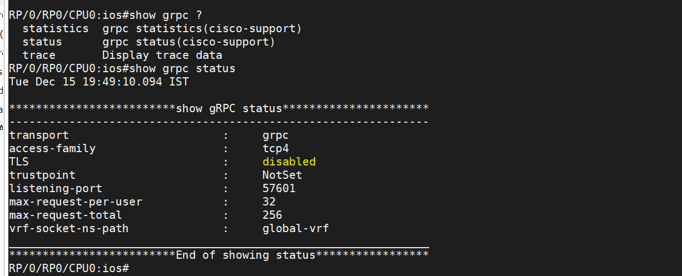
gNMI Configuration in CISCO IOSXR

Slide 8
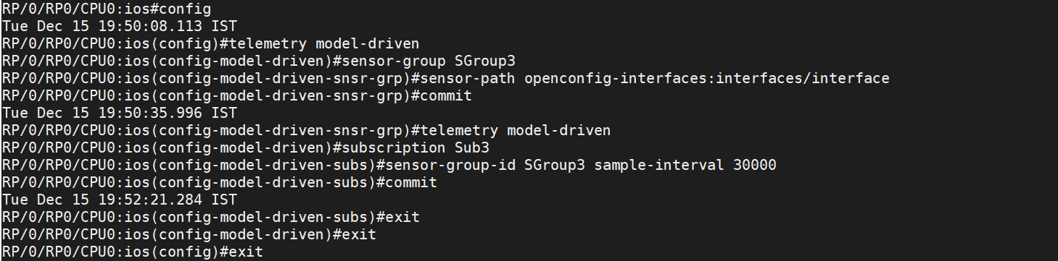
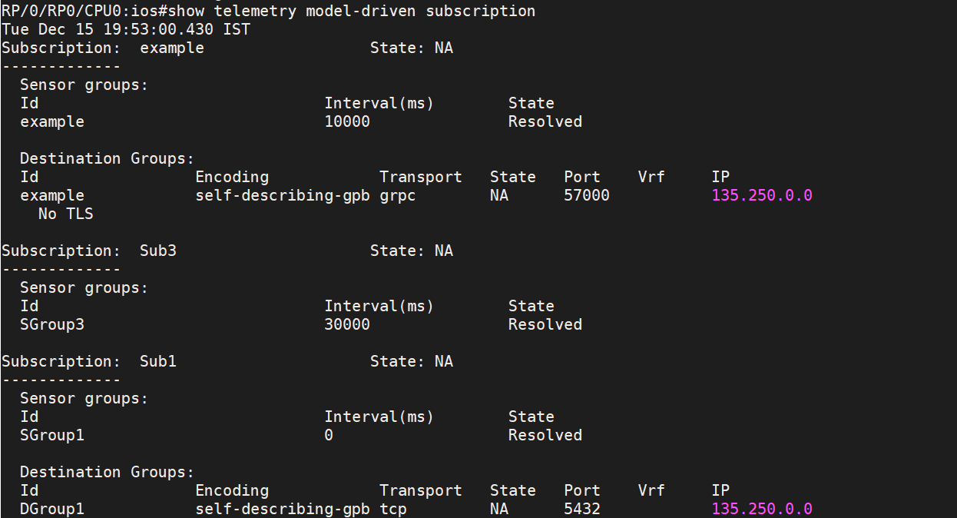
Continue….

Slide 9
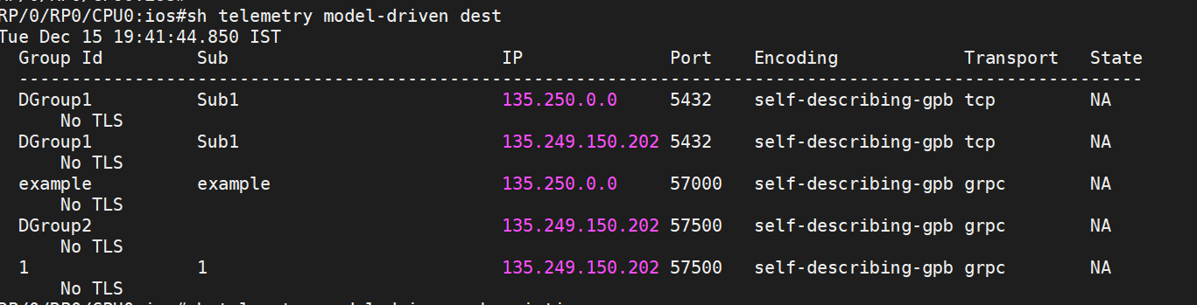

Slide 10
Enabling gNMI debug in Karaf
nsp@MDM-1084776467()> gnmi-debug –help
DESCRIPTION
nokia:gnmi-debug
For gNMI stats collection debugging
SYNTAX
nokia:gnmi-debug subCommand
ARGUMENTS
subCommand
Sub-command, one of: gnmiDebugInfo, gnmiSubscriptionDetails, subscriptionIds, debugMetrics,
bufferPoolMetrics, config, dumpCaches
(required)
nsp@MDM-1084776467()> gnmi-debug gnmiDebugInfo

Slide 11
Steps to support gNMI via NSP for CISCO IOSXR Node
Find out the respective Openconfig device Model for which NSP will subscribe for Notifications:
"includedRootModules":
["openconfig-aaa", "openconfig-alarms", "openconfig-extensions", "openconfig-interfaces", "openconfig-lldp", "openconfig-platform", "openconfig-procmon", "openconfig-system", "openconfig-system-logging", "openconfig-system-management", "openconfig-system-terminal“]
“generateGnmi”:true flag will be used for auto code generation.
gNMI mediation policy is mandatory during discovery(gRPC Port range : 57344 to 57999)
MR To be referred for CISCO IOSXR:
WIP: Support gNMI for Cisco NCS 5501 7.x. (!36) · Merge Requests · mdm / mdm-device-model-comm-netconf-cisco-iosxr · GitLab (alcatel-lucent.com)

